Slide 1
AWS-CLOUD
Presented by
J.H.Mahalakshmi,
Pragati Engineering College,
IV-IT

Slide 2
Agenda
Connect Windows EC2 instance
Introduction to AWS Console Introduction to IaaS Hands-on - Elastic Compute cloud (EC-2) Windows instance Connect to Windows Instance Configure Web server on Windows Instance
Tasks
1. Create windows free tier EC2 instance 2. Install XAMPP webserver on it 3. Deploy personal website on it 4. Terminate EC2 instance

Slide 3
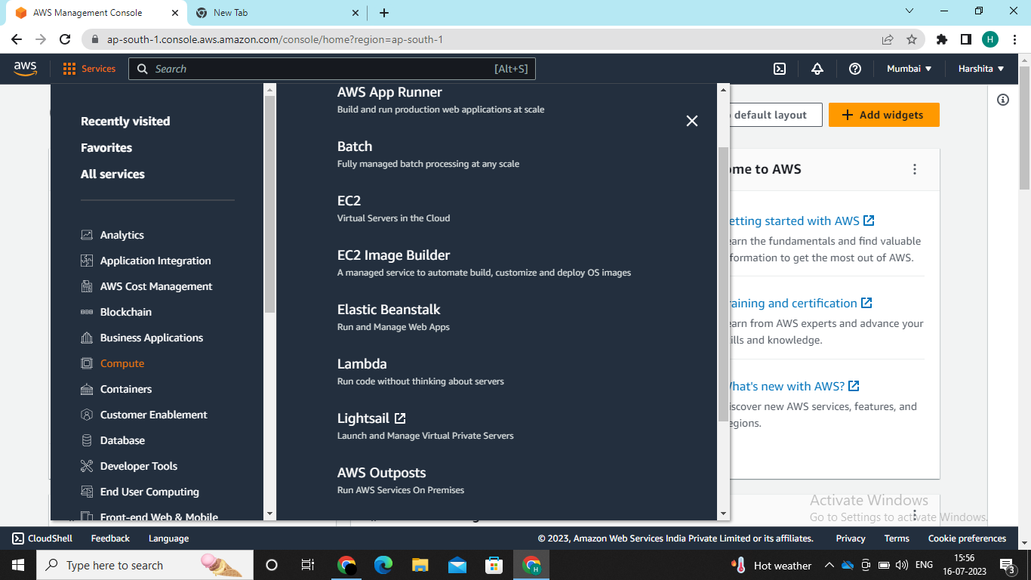
Connect Windows EC2 instance
Hands-on - Elastic Compute cloud (EC-2)Windows instance->IaaS
EC-2->set up & configure the Operating Systems and applications that run on
your instance

Slide 4
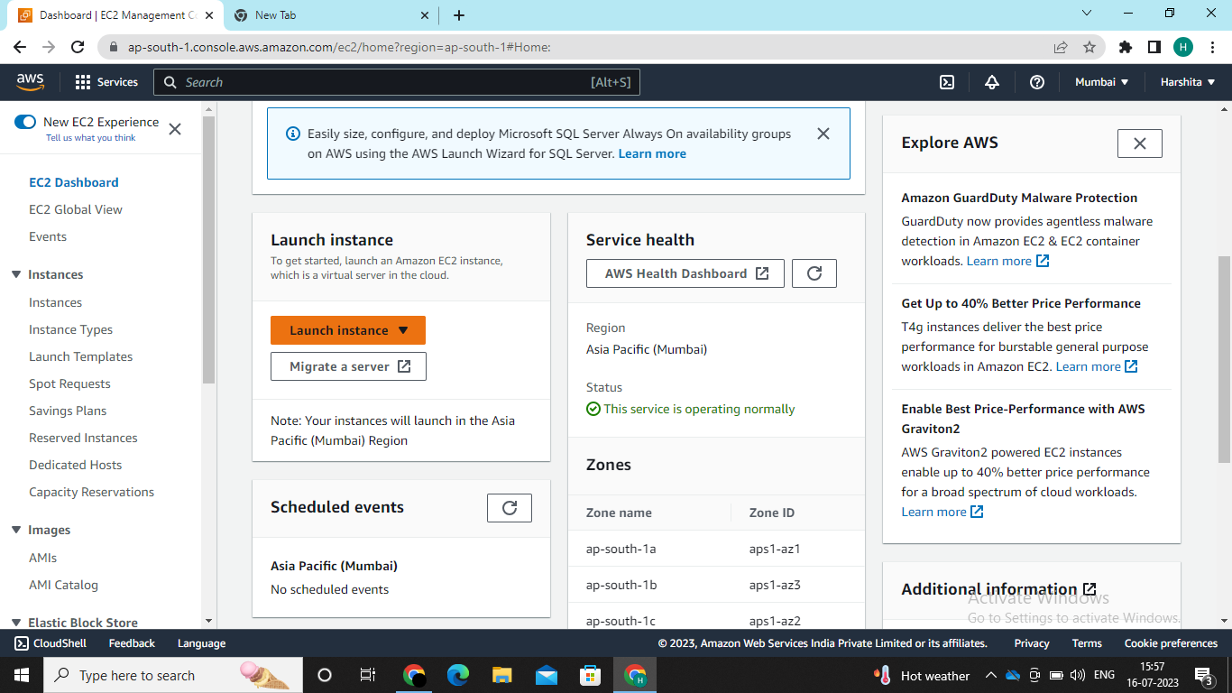
Steps for Launching a Instance
EC2>Instance->Launch Instance
Name & tags
Application and
OS Image(AMI)
Instance type
Key pair(Login)
Network Settings
Configure Storage
Advance details

Slide 5
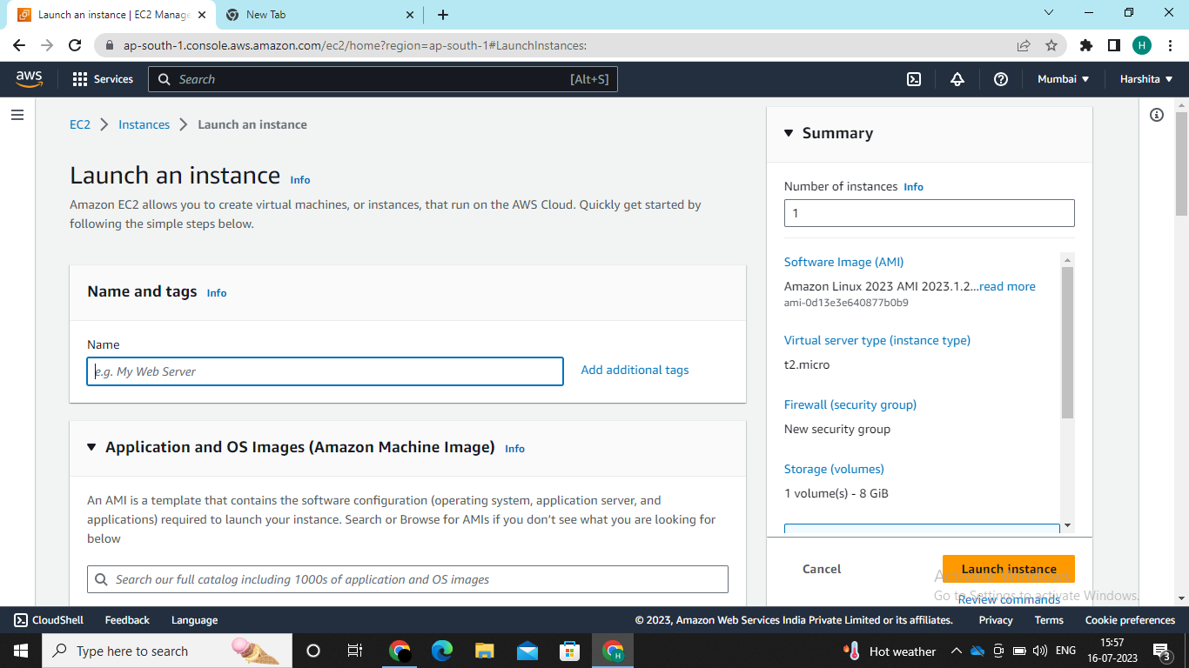
Give Name & Tags-TalentNextWindows

Slide 6
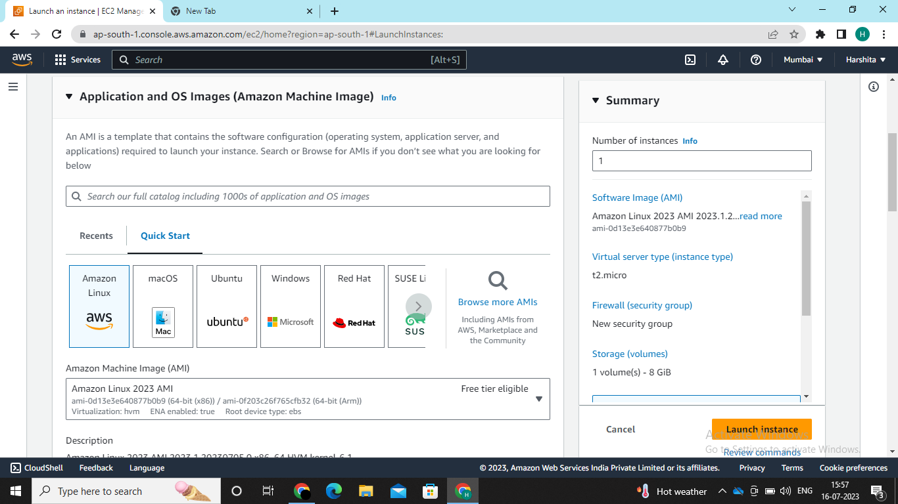
Selecting windows operating systems as windows in AMI ,as AMI has 47 OS available on aws-cloud

Slide 7
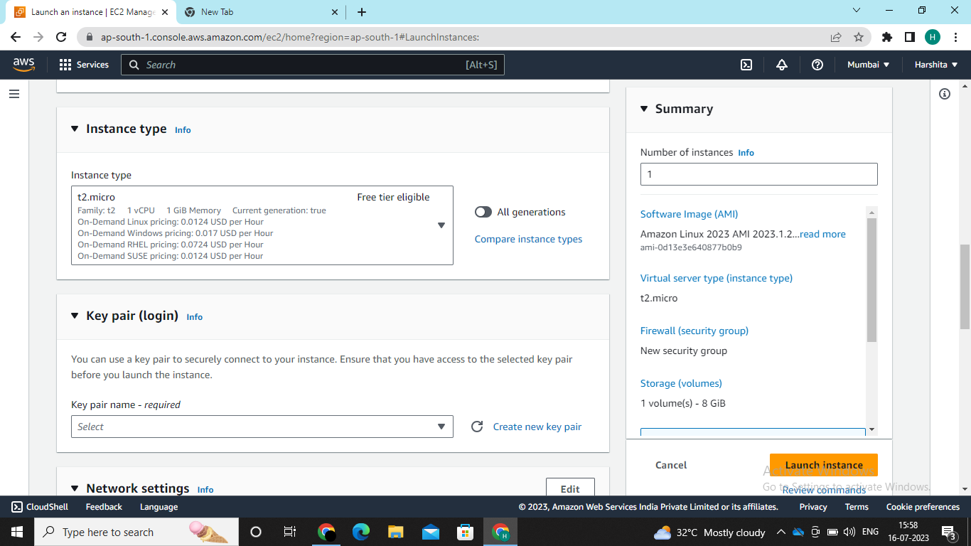
Select Instance Type as t2.micro which is free and Key Pair(login) allows you to connect to your instance securely and here you need to download the created key pair to your desktop

Slide 8
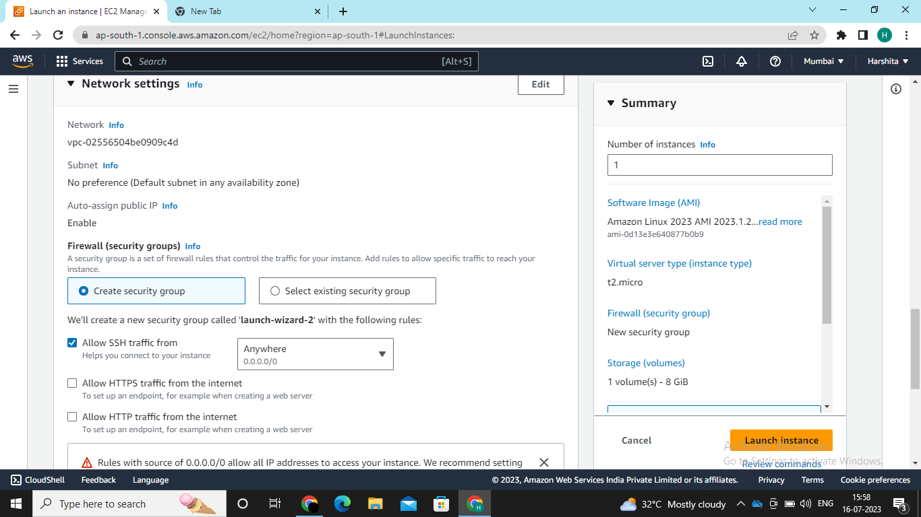
Network Settings you need to create the security group where we have options RDP to connect with instance ,SMPT to mails ,HTTP to web servers

Slide 9
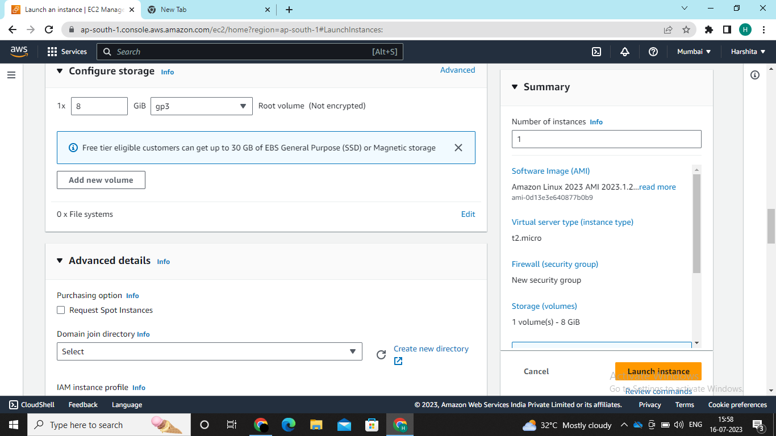
Configure Storage –select 30GB and General purpose SSD(gip2) or magnetic storage & Advance details as default

Slide 10
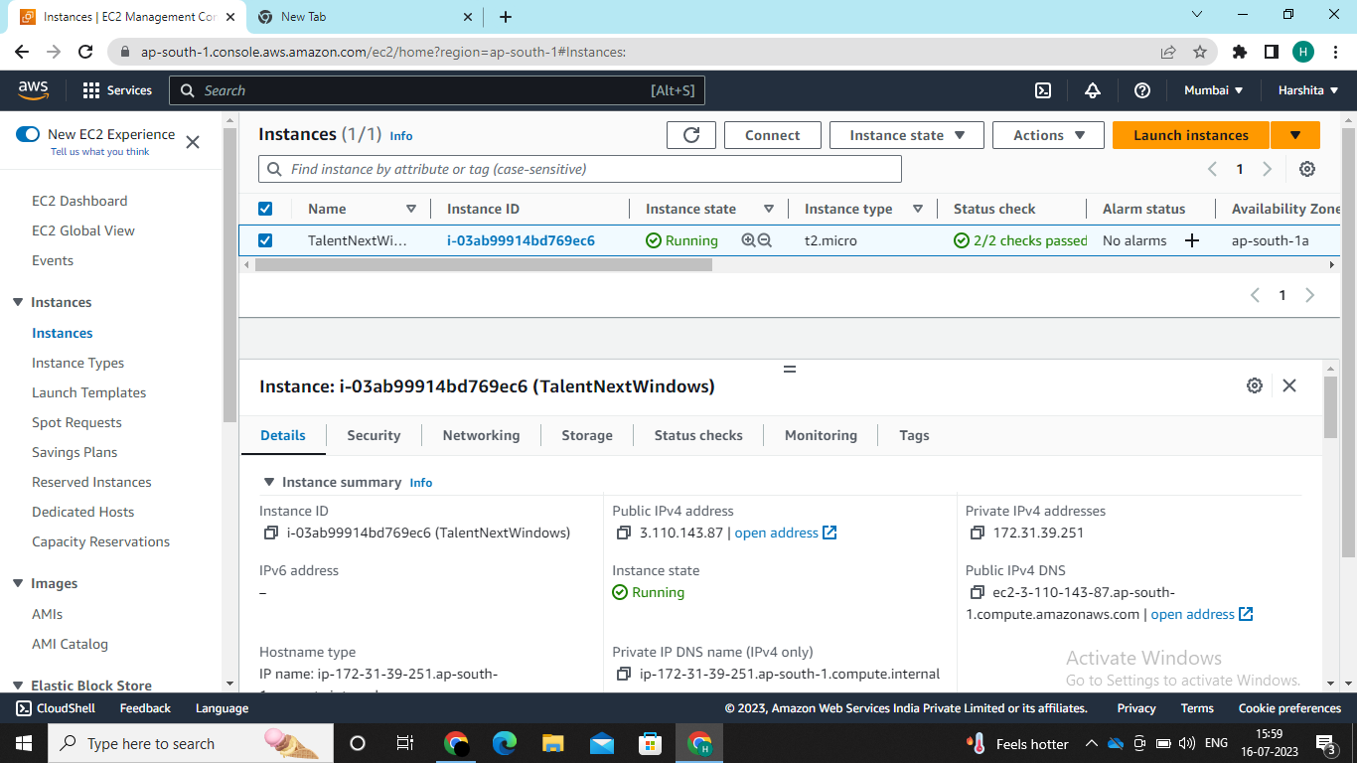
Launch Instance

Slide 11
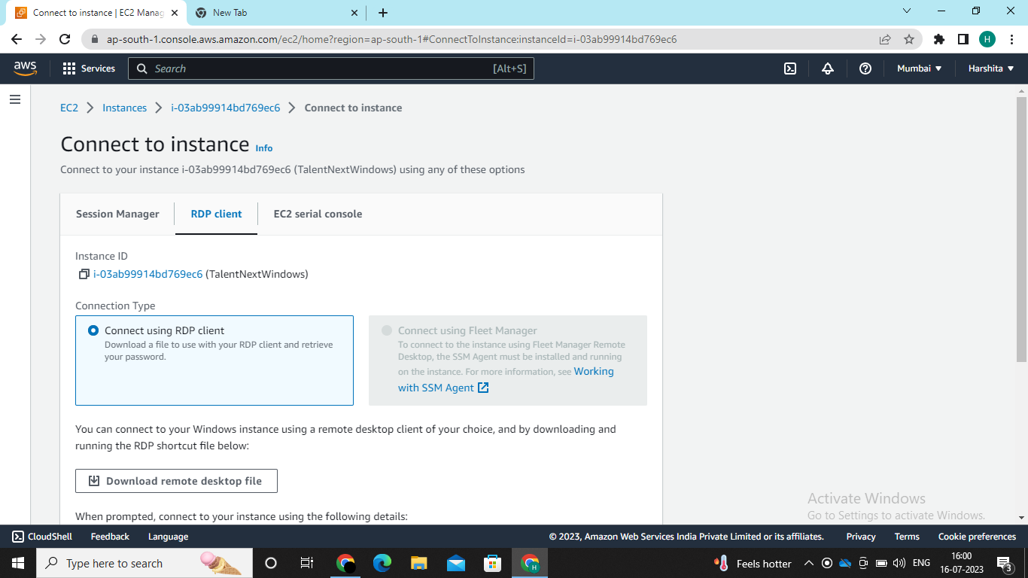
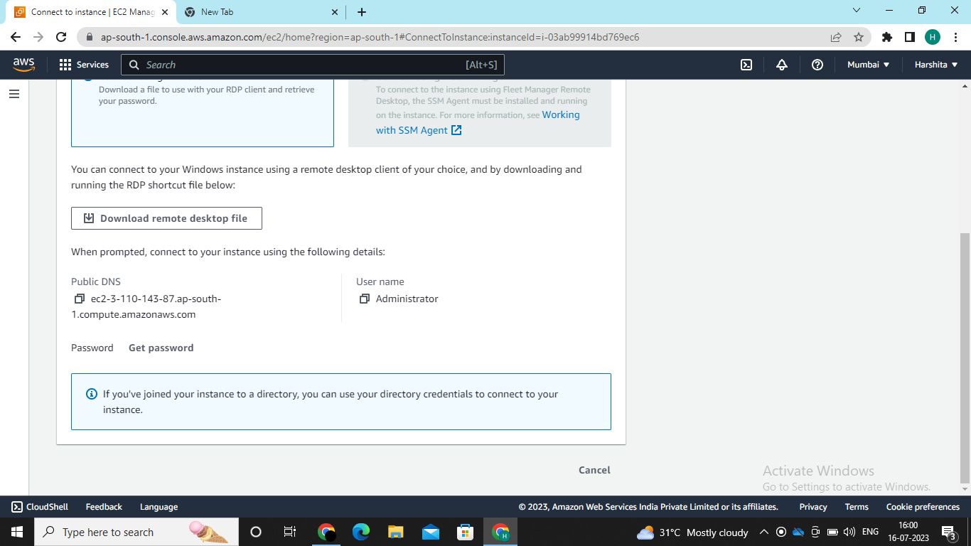
Now connect the instance to RDP Client and downlaod the the desktop file and copy the password

Slide 12
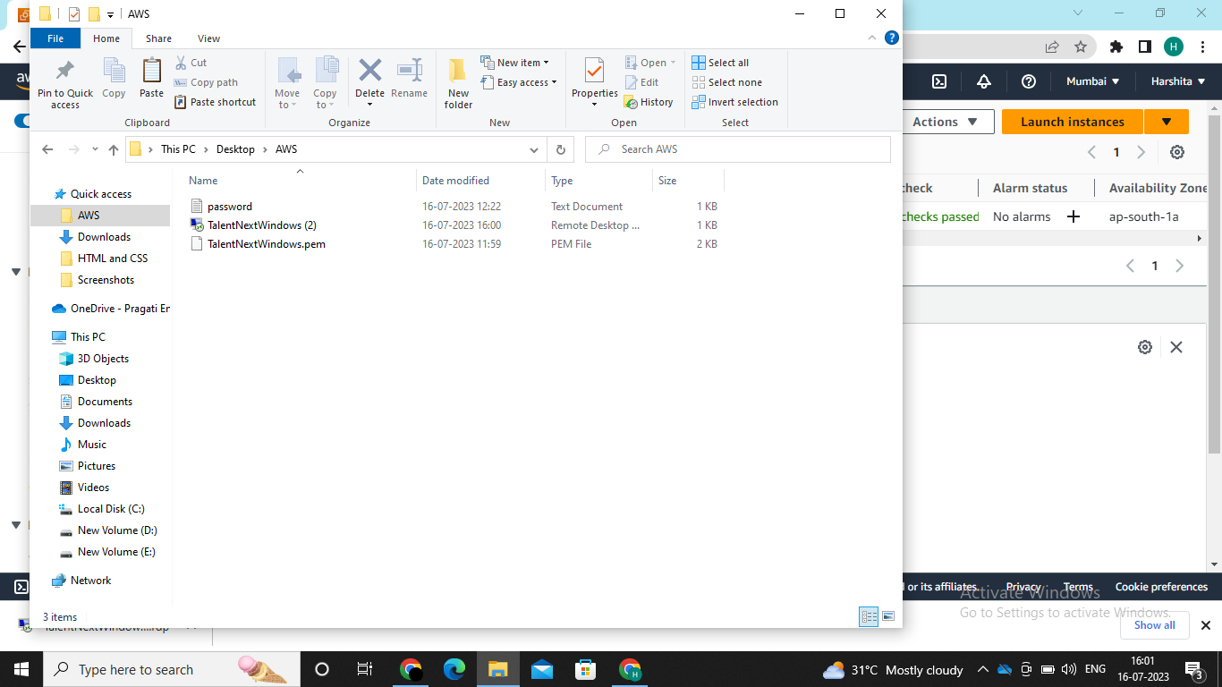
Now open the desktop file and enter the password you copied the your virtual machine that you created will be opened.

Slide 13
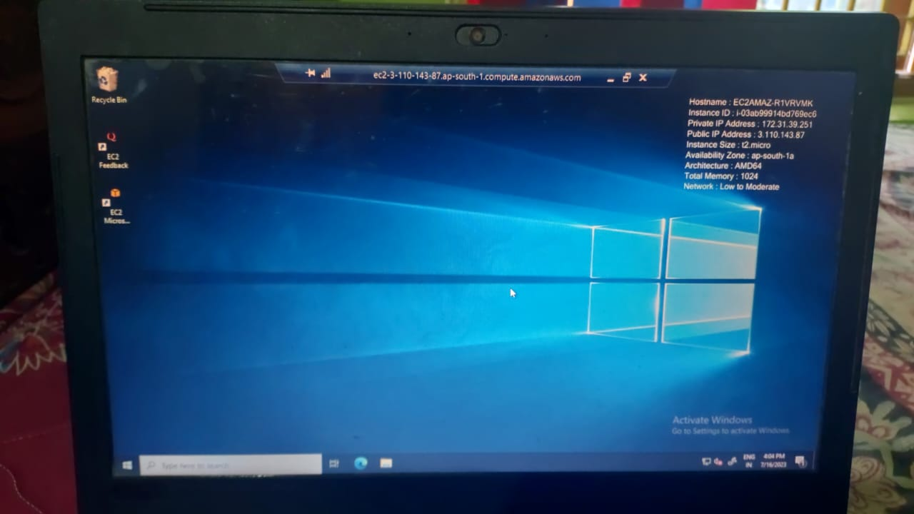
Created Virtual machine will look like this

Slide 14
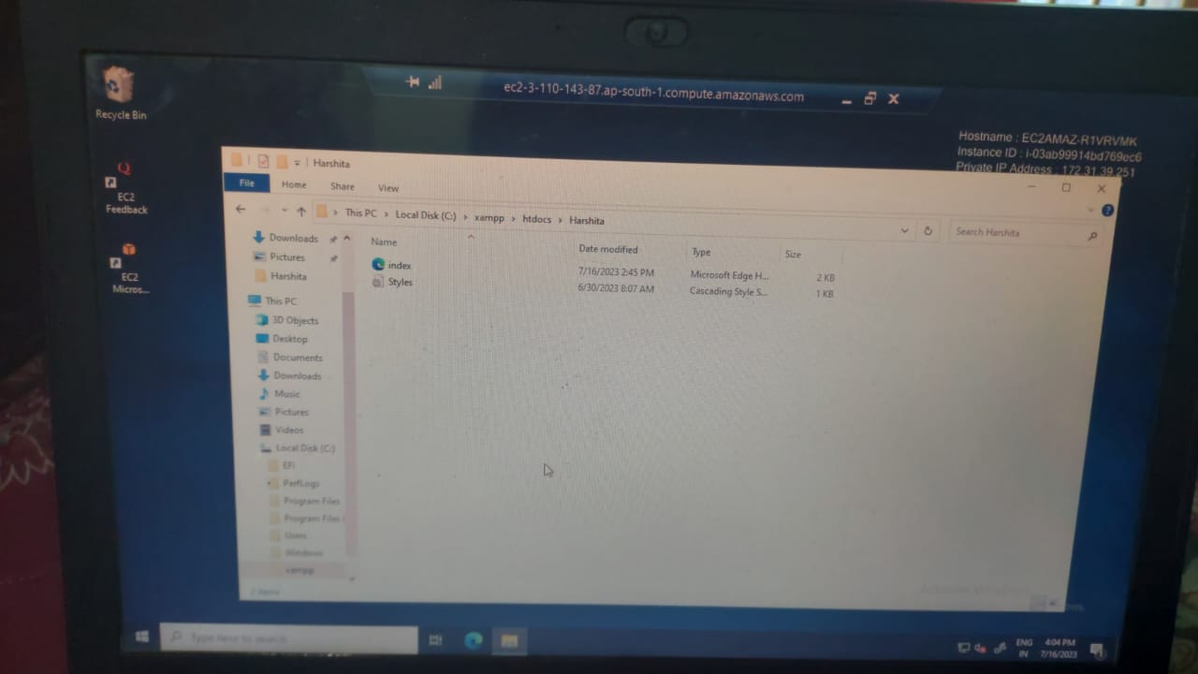
Install XAMPP webserver on it Open XAMPP start Aapche (has port 80,443) c-drive->xampp->htdocs->create a new folder(x)->create files like html,css etc Deploy our webiste on it as follows

Slide 15
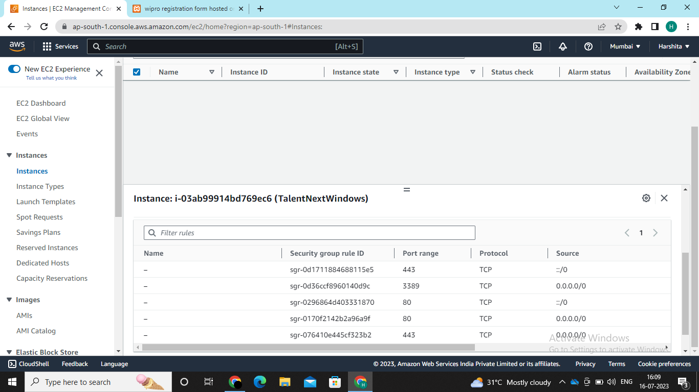
Create the inbound rules to permit the request outside the cloud and keep the outbound rules as default as the request are allowed from aws cloud to outside world

Slide 16
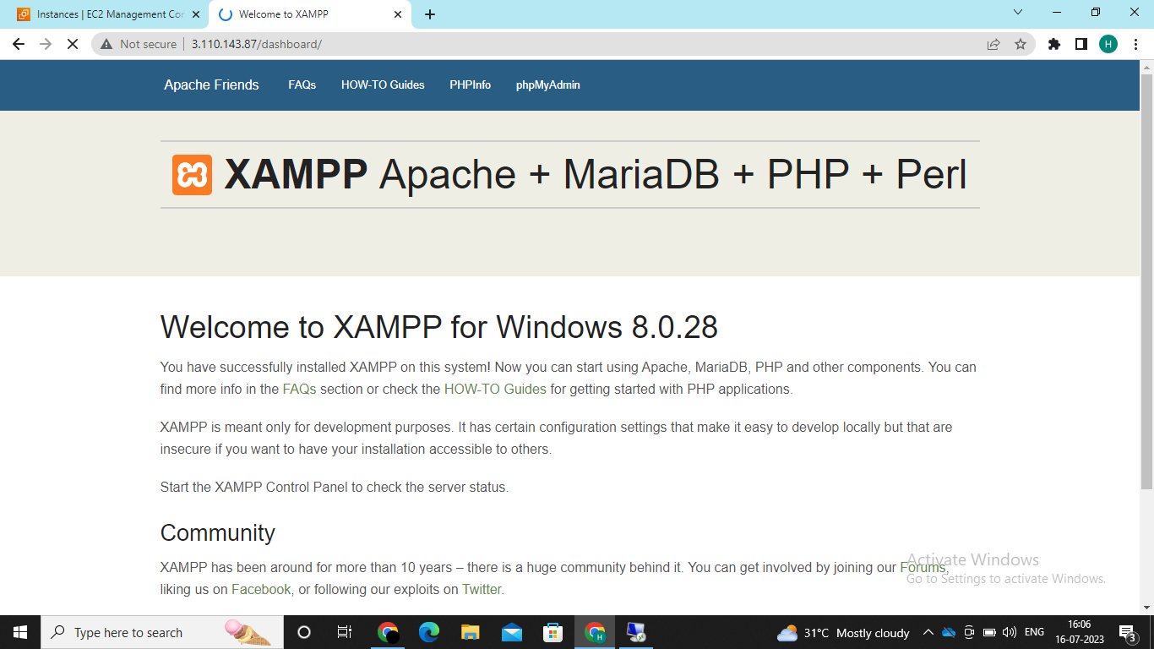
Now open the instance that you have created then go to details Either copy public DNS address or public IPv4 and paste it on the browser of your device then the default XAMPP window will be opened

Slide 17
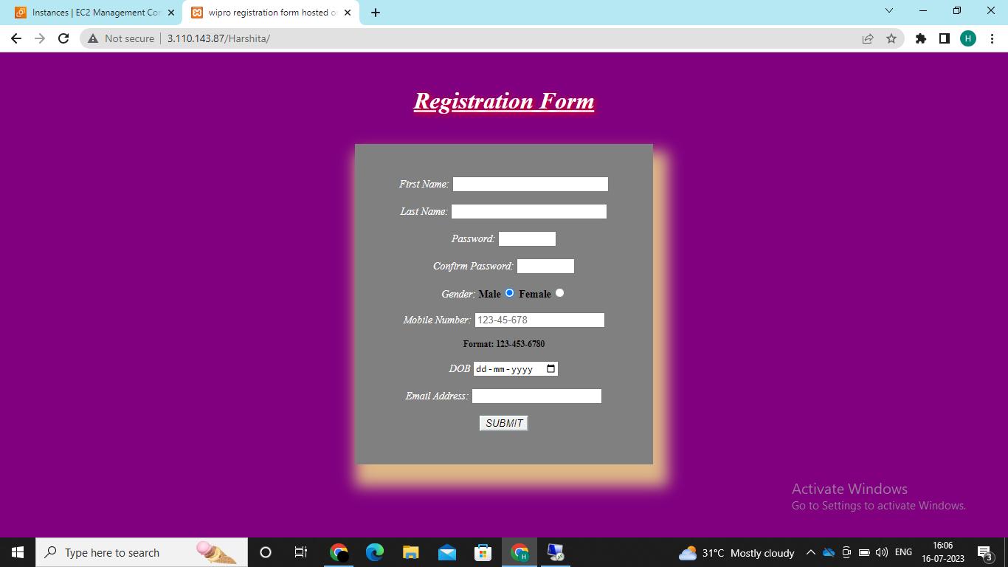
Now change the xampp dashboard to the created folder for example 65.1.136.174/dashboard/--→65.1.136.174/foldername Now terminate the instance that you have created lastly

